Slide 1
Notes:
SAS and all other SAS Institute Inc. product or service names are registered trademarks or trademarks of SAS Institute Inc. in the USA and other countries. ® indicates USA registration. Other brand and product names are trademarks of their respective companies.

Slide 2
Unleashing the true Power of SAS® For Warranty Analytics for Automobile Industry
Paper 2905

Slide 3

Presenters’ Bio
Shiv Kumar,
Dy. General Manager - Information Insight Centre, Mahindra and Mahindra
Prateek Kumar Singh,
Consultant – Information Insight Centre, Mahindra and Mahindra
Shiv is a data science and Strategy Consulting practitioner with 11 years of experience in the field of management consulting and predictive analytics solutions. Served leading organisations in the area of credit risk, retail analytics, Marketing and Sales Analytics, reliability engineering, Demand forecasting, social media analytics.
Shiv has been speaker on predictive analytics at various professional and academic forums. Graduated in mathematical Statistics from Institute of Science – BHU Varanasi and MBA from Indian Institute of Management- Kozhikode
Prateek Kumar Singh is a Consultant at Bristlecone India Ltd., working with Mahindra & Mahindra. Around 4+ years of experience as a SAS Programmer in IT environment with an extensive experience in Banking/Finance domain. Experienced in migration of large data in SAS. Experience with SAS components including SAS/BASE,SAS/SQL, SAS/MACRO, and SAS/ODS.
Having excellent command in producing reports, employing various SAS procedures. Adept in mapping business requirements, designing customized solutions with strong analytical skills and ability to analyze business practices and define optimal procedures Good understanding of the functioning of primary and secondary capital markets.

Slide 4
Presenters’ Bio
Paresh Peter Rodrigues,
Associate Consultant – Information Insight Centre, Mahindra and Mahindra
Saket Shubham,
Consultant – Information Insight Centre, Mahindra and Mahindra
Paresh Peter Rodrigues is a Associate Consultant at Bristlecone India Ltd., working with Mahindra & Mahindra where he has been since 2015. Around 3+ years of experience as a SAS Programmer. He is a SAS Certified Professional and perceived Bachelor of Computer Engineering from Xavier Institute of Engineering, Mumbai as a full time graduate. Also have been learning various tools in SAS while working for Mahindra being a Client.
Along with Base and Advanced SAS, Paresh is enthusiast for working and developing things in SAS Visual Analytics. He currently lives in Mumbai, Maharashtra, India and looking ahead to work and grow ahead in SAS.
Saket Shubham is Consultant at Bristlecone India Ltd., working with Mahindra & Mahindra. A data science professional with around 3 years of experience in predictive analytics field. Served leading organizations in the domain of Warranty, Automobile, Insurance, Telecom, Banking and Marketing (Sales Forecasting).
Adept in mapping business requirements, designing customized solutions with strong analytical skills and ability to analyze business practices and define optimal procedures. Graduated from Indian Institute of Technology, Kharagpur in Industrial Engineering.

Slide 5
AGENDA
Agenda
Introduction to Warranty Analytics
SAS Visual Analytics – an overview
Introduction to Data
Events Data and Manufactured & Sold Data
Key terminologies and KPIs
Data Manipulation
Complexities in Combining data
Time-in-Service bins creation
Innovative report building on VA
Scaling-up to Predictive Analytics using the organized data
Key Take-aways

Slide 6
Introduction to Warranty Analytics
Current Challenges and Roadblocks

Slide 7




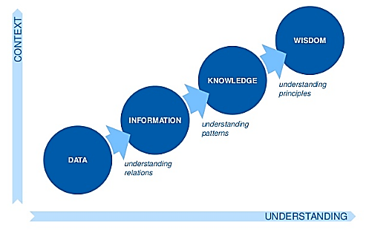
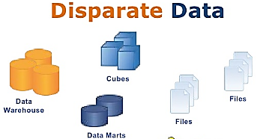
Introduction to Warranty Analytics
Warranty Analytics involves combining warranty and other field data with key customer, product and geographic information
It enables organizations to quicken detection and reduce time to correction, lowering warranty costs and increasing customer satisfaction.
Why Warranty Analytics?
Industries using Warranty Analytics
1
2
Automobiles
Electronics
Total Sales
3
4
Aviation
Appliances
Notes:
Manufacturers typically spend 2–5 percent of sales on warranty costs
Organizations are struggling to combine and analyze increasing volumes of disparate data to get the insights
~70% of the warranty expenses dwindle due to repetitive failure in the performance of parts
Making correct use of the opportunity requires robust warranty analytics that can integrate raw data into actionable plans to accomplish the desired results

Slide 8
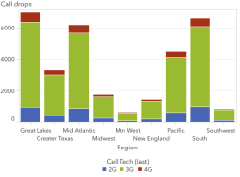
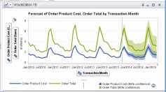
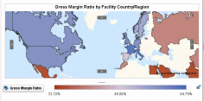
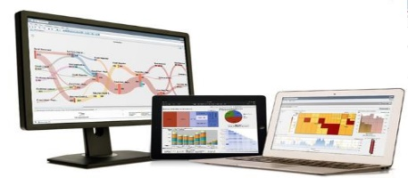
SAS Visual Analytics (VA)
SAS Visual Analytics provides a complete platform for analytics visualization, enabling to identify patterns and relationships in data that weren’t initially evident
Interactive, self-service BI and reporting capabilities are combined with out-of-the-box advanced analytics so everyone can discover insights from any size and type of data, including text.
Key Features
Single application for reporting, data exploration and analytics
Auto-charting
Self-service analytics for everyone
Text analysis
Interactive reporting and dashboards
Flexible deployment options
Innovative visualizations
Notes:
A single application for reporting, data exploration and analytics - Explore data through interactive visualization and easy-to-use analytics. Design and distribute reports and dashboards
Innovative visualizations - Present data and results in the most compelling way with advanced data visualization techniques and guided analysis through auto-charting
Auto-charting - Start explorations from the most ideal point and automatically pick the best graph for your data
Self-service analytics for everyone - Automated forecasting, goal seeking, scenario analysis, decision trees and more are right at your fingertips
Text analysis - Gain insight into hot topics in social media and other text data, and know whether sentiment is positive or negative
Interactive reporting and dashboards - A single user interface lets you go directly from reporting and exploration, to analysis, to sharing information through different channels, including Microsoft Office applications
Location analytics - Combine traditional data sources (transactional, customer, operational, etc.) with location data for analysis in a geographical context
Mobile BI - Use native mobile apps for iOS, Windows 10 and Android to view and interact with others through dynamic reports and dashboards on tablets and smartphones
Flexible deployment options - Runs on commodity hardware, in a private or public cloud infrastructure, or Cloud Foundry platform as a service (PaaS)

Slide 9
Introduction to Data

Slide 10
Data needed for Warranty Analytics
Integrating warranty and other field data with key customer, product and geographic information
Make and Model
Production Data
Production and Sales related Dimensions
Dealer details and demographics e.g., region, zone etc.
Transactions Data
Sales Data
Dimensions Data
Repairing dealer details
Warranty Claims/Events data
Claims/Events related dimensions
Failure details e.g. part, vehicle system, failure mode etc.
Customer demographics
Notes:
Need a combination of warranty events data along with the production and sales data
Important to understand the rates at which warranty events are received or the payments are made toward those events
Data exists in different transaction systems - One system records the production and sales of the vehicles and another system contains information about failures and warranty events for these vehicles.
Exploited various unconventional programming techniques to combine and manipulate the data into the desired form for use with SAS® Visual Analytics

Slide 11
Events Data
Events data consists of:
A set of transaction tables containing warranty events and basic information about them like the complaint group responsible for a particular Event, replaced Part-codes, labor-codes, date of failure etc.
Master tables mostly contain descriptions of complaint group-codes, part-codes etc.
Following table represents the events data sans code descriptions:
VIN Number | Claim Id | Group Code | Comp.Code | Part | Event | Cost
ABC | 123 | G1 | C1 | P1 | 1 | 100
ABC | 123 | G1 | C1 | P2 |  | 50
ABC | 123 | G1 | C1 | P3 |  | 50
ABC | 123 | G1 | C2 | P4 | 1 | 20
ABC | 123 | G1 | C2 | P5 |  | 30
ABC | 123 | G2 | C3 | P6 | 1 | 60
ABC | 124 | G1 | C1 | P1 | 1 | 100

Slide 12
Manufactured and Sold Data (MnS)
Set of transaction and master tables containing the manufactured and sold details of each vehicle
Includes various attributes of the vehicles like
Production Month and year
Plant/facility
Vehicle Type
Model name
Variant Name
Dealer to which it was billed etc.
The total no. of VIN numbers in the data is the number of vehicles sold.
Following table represents the MnS Data:
VIN Number | Prod. Month | Prod. Year | Model | Dealer | Zone
ABC | Apr | 2016 | YYY | X123 | Zone1
PQR | May | 2016 | QQQ | X212 | Zone2

Slide 13
Key KPIs and Terminologies used
Production Month-
Production month is derived from the production date of a vehicle. All the vehicles produced in a particular month are said to be of the same batch.
Ex. - All vehicles produced in ‘Jan-2016’ are said to be of the Batch “Jan16”
Claim/Event-
A Unique combination of Claim Id, Group Code and Comp-Code is considered as 1 Event.
A claim can have one or more events depending on the Group Codes and Complaint Codes.
Manufactured and Sold Nos. (M&S)-
Total M&S for a particular Prod. Month is the number of vehicles sold from that production batch
Ex. - Suppose total no. of vehicles produced in the month of Jan-16 was 2000 and so far 1400 of those vehicles have been sold. In this case, M&S for Jan-16 is 1400.
Notes:
Production month lies at the base of every analysis in this project. Following is the code to extract Month and year from production date:
Prod_month = input (substr (put (prod_date, date9.), 3, 7), monyy7.);
Format Prod_month monyy7.;
In the above table, there are 2 events but 4 events. Further, Multiple parts can be replaced in 1 Event.
Total events for a particular Prod. Month is the no. of events that occurred on vehicles that were produced in that month.

Slide 14
Warranty Cost
It is the cost incurred toward the events (includes cost of replaced parts and cost of labor)
Claim Rate (CR)
CR is estimated as no. of events per hundred vehicles sold from that month’s produce
CR= (Event/MnS)*100
Warranty Cost Per Vehicle (WCPV)
It is the average warranty cost incurred per vehicle from particular month’s produce
WCPV= (Warranty Cost/MnS)
Notes:
Note: CR and WCPV will be calculated in SAS® Visual Analytics as they are aggregated measures.

Slide 15



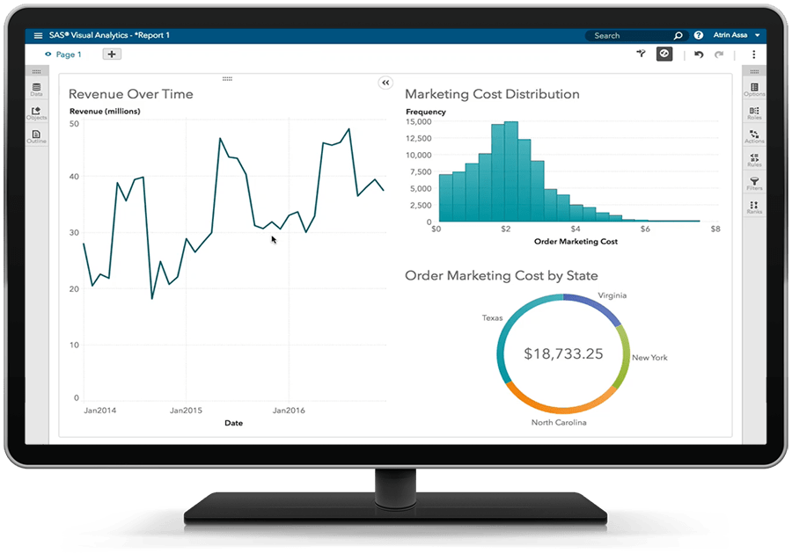

Data Manipulation – Complexities and solutions
Deriving KPIs from combined data (Production, Sales and Claims)
Events
Production & Sales
LASR Server
Aggregated Measures
VA Dashboard
X
Y
X/Y
Challenges
Combining Data sets
While a VIN is unique in the MnS data (as in it is sold only once), in events data, there can be multiple events on the same VIN
One-to-many join makes it difficult to calculate correct M&S numbers
Notes:
To calculate CR and WCPV in SAS VA, events data and MnS data needed to be merged together to relate the events to relate the events with the prod. months of the vehicles on which they occurred. Thus the two data sets had to be joined based on the VIN numbers.

Slide 16
2. TIS Buckets
“Time in Service” is the no. of months a vehicle has completed in service before a failure occurs
Each event may fall in separate TIS Bucket depending on the no. of days between sale date and failure date
Some of the TIS Buckets are:
0 TIS – Contains all events that occur before the sale (Pre Delivery Inspections or PDI)
3 TIS - Contains all the events that occur within 90 days from sale.
12 TIS - Contains all the events that occur within 360 days from sale.
Sample Representation
TIS | Months
0 TIS | 0
1 TIS | 0 | 1
3 TIS | 0 | 1 | 2 | 3
6 TIS | 0 | 1 | 2 | 3 | 4 | 5 | 6
12 TIS | 0 | 1 | 2 | 3 | 4 | 5 | 6 | 7 | 8 | 9 | 10 | 11 | 12
Notes:
Every Event on a vehicle is assigned a TIS bucket based on the difference between the date of Event and sale date
If a vehicle is retailed on 01-Jan-2016 to the end customer and an Event occurs in the vehicle on 15-Feb-2016, then for this Event:
Event date – sale date = 46 days.
Hence, this Event will not appear in of “0 TIS” or “1 TIS” but will be considered as a part of “3 TIS” and all the higher TIS buckets. It can be said that this Event occurred within 12 months of service and within 6 months of service, even within 3 months of service but not within 1 month of service.
Table - The table explains that the events that occurred in the 0th month should be reflected in the 0 TIS, 1 TIS, 3 TIS and so on. Similarly, events that occur in the 1st month should show in 1 TIS, 3 TIS, 6 TIS and so on.

Slide 17
To achieve the mentioned TIS Buckets, the data needs to be multiplied, which means that 1 Claim Id will be repeated multiple times in the data.
VIN Number | Claim Id | Part | Event | Cost | TIS Bucket
ABC | 123 | P1 | 1 | 100 | 0 TIS
ABC | 123 | P2 |  | 50 | 0 TIS
ABC | 123 | P3 |  | 50 | 0 TIS
ABC | 123 | P1 | 1 | 100 | 1 TIS
ABC | 123 | P2 |  | 50 | 1 TIS
ABC | 123 | P3 |  | 50 | 1 TIS
ABC | 123 | P4 | 1 | 20 | 1 TIS
ABC | 123 | P5 |  | 30 | 1 TIS
ABC | 123 | P6 | 1 | 60 | 1 TIS
ABC | 123 | P1 | 1 | 100 | 3 TIS
ABC | 123 | P2 |  | 50 | 3 TIS
ABC | 123 | P3 |  | 50 | 3 TIS
ABC | 123 | P4 | 1 | 20 | 3 TIS
ABC | 123 | P5 |  | 30 | 3 TIS
ABC | 123 | P6 | 1 | 60 | 3 TIS
Notes:
As it is, one Claim Id is repeated as it contains more than one Event and multiple parts. So assuming that the events in Table1 (events data) are 0 TIS events, after adding TIS buckets, the data will look like:(Only adding 0, 1 and 3 TIS for representation)
TIS is an attribute of the events and should not affect the manufactured and sold nos. Meaning, regardless of the TIS selected in the dashboard, the MnS Nos. should remain constant.

Slide 18
VIN Number | Claim Id | Group Code | Comp. Code | Part | Event | Cost | TIS Bucket
ABC | 123 | G1 | C1 | P1 | 1 | 100 | 0 TIS
ABC | 123 | G1 | C1 | P2 |  | 50 | 0 TIS
ABC | 123 | G1 | C1 | P3 |  | 50 | 0 TIS
ABC | 123 | G1 | C2 | P4 | 1 | 20 | 0 TIS
ABC | 123 | G1 | C2 | P5 |  | 30 | 0 TIS
ABC | 123 | G2 | C3 | P6 | 1 | 60 | 0 TIS
ABC | 124 | G1 | C1 | P1 | 1 | 100 | 0 TIS
ABC | 123 | G1 | C1 | P1 | 1 | 100 | 1 TIS
ABC | 123 | G1 | C1 | P2 |  | 50 | 1 TIS
ABC | 123 | G1 | C1 | P3 |  | 50 | 1 TIS
ABC | 123 | G1 | C2 | P4 | 1 | 20 | 1 TIS
ABC | 123 | G1 | C2 | P5 |  | 30 | 1 TIS
ABC | 123 | G2 | C3 | P6 | 1 | 60 | 1 TIS
ABC | 124 | G1 | C1 | P1 | 1 | 100 | 1 TIS
ABC | 123 | G1 | C1 | P1 | 1 | 100 | 3 TIS
ABC | 123 | G1 | C1 | P2 |  | 50 | 3 TIS
ABC | 123 | G1 | C1 | P3 |  | 50 | 3 TIS
ABC | 123 | G1 | C2 | P4 | 1 | 20 | 3 TIS
ABC | 123 | G1 | C2 | P5 |  | 30 | 3 TIS
ABC | 123 | G2 | C3 | P6 | 1 | 60 | 3 TIS
ABC | 124 | G1 | C1 | P1 | 1 | 100 | 3 TIS

Slide 19
Solution for challenges Faced
Step1
Create a variable to denote the no. of days between the sale date and Event date in the events data with
TIS_days = intck (days, sale_date, Event_date);
data TIS_buckets; length TIS_Bucket_ $ 6; input min max TIS_Bucket_$ ; infile datalines dlm= ","; datalines; 0,0,0 TIS 0,90,3 TIS 0,360,12 TIS ; run; proc sql; create table events_data1 as select a.*,b.TIS_bucket_ from events_data as a inner join TIS_buckets as b on a.TIS_days >= b.min and a.TIS_days <= b.max; quit;
Step2
Create a small data set with the required TIS Buckets and join this data set with the events data to multiply the data into temporary TIS Buckets with following logic

Slide 20
Step3
Combining events data with MnS data: Using these temporary TIS Buckets, create separate data sets for each TIS and combine them with the whole MnS data
%macro TIS(a); proc sql; create table join_&a as select a.*,b.*,"&a TIS" as TIS_Bucket length = 6 from EVENTS_DATA1 as a right join MnS_data as b on a.vin_no = b. vin_no and a.TIS_bucket_ = "&a TIS"; %mend TIS; %TIS(0); %TIS(3); %TIS(12);
Step4
Append these data sets together:
proc append base=join_0 data=join_3; proc append base=join_0 data=join_12; run;

Slide 21
Step5
Create unique keys to identify events and unique VINs and use them to create flags.
Data is sorted twice:
By Event key to create Event flag
By MnS key to create MnS flag.
These flags will be used in SAS® VA report builder to calculate Events and MnS Nos.
data PNI_keys; length MnS_key$ 25 event_key$ 120; set join_0; event_key = compress(Group_code||Complaint_Code||TIS_bucket); MnS_key = compress(VIN||TIS_bucket); run; proc sort data=PNI_keys out=PN1; by MnS_key; run; data pni_keys; set PN1; by MnS_key; if first.MnS_key then MnS_flag = 0; MnS_flag +1; run; proc sort data=pnI_keys out=PN2; by event_key descending Event; run; data Data_for_VA; set PN2; by event_key; if first.event_key then event_flag = 0; event_flag + 1; run;
Further challenges can be resolved through functionalities available in SAS VA

Slide 22
Report Building
….

Slide 23
Report Building
1. Event Attribute Filters
CR = (Event/MnS) * 100
There are 2 unique VINs denoting that 2 vehicles have been and the total no. of events on those vehicles is 5. Hence,
CR = 5/2 *100 = 250
VIN Number | Claim Id | Group Code | Comp. Code | Part | Event | Cost | Cost of Event | TIS Bucket | Prod. Month
ABC | 123 | G1 | C1 | P1 | 1 | 100 | 200 | 3 TIS | Jan - 16
ABC | 123 | G1 | C1 | P2 |  | 50 |  | 3 TIS | Jan - 16
ABC | 123 | G1 | C1 | P3 |  | 50 |  | 3 TIS | Jan - 16
ABC | 123 | G1 | C2 | P4 | 1 | 20 | 50 | 3 TIS | Jan - 16
ABC | 123 | G1 | C2 | P5 |  | 30 |  | 3 TIS | Jan - 16
ABC | 123 | G2 | C3 | P6 | 1 | 60 | 60 | 3 TIS | Jan - 16
ABC | 124 | G1 | C1 | P1 | 1 | 100 | 100 | 3 TIS | Jan - 16
EFG | 165 | G3 | C8 | P12 | 1 | 120 | 120 | 3 TIS | Jan - 16
Notes:
Filtering the data as per the attributes of the events should not have any effect on the number of vehicles billed

Slide 24
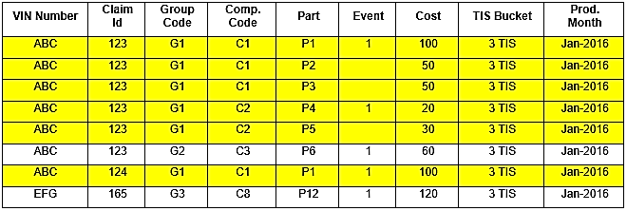
If user selects G1 from the Group Code Filter, the system would return the highlighted rows:
MnS returned by the system now is 1 instead of 2 which leads to the following claim rate calculation:
CR = 3/1 *100 = 300
Whereas, the correct calculation should be:
CR = 3/2 * 100 = 150

Slide 25
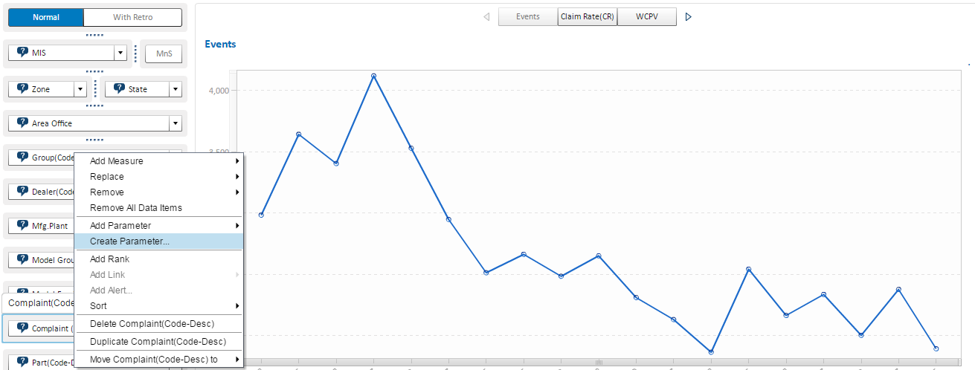
Solution
Step1: Create Parameters on all the control Objects containing Event attributes.
Notes:
To solve this problem, we need to make sure that the control objects containing Event attributes do not filter the chart/graph directly so that MnS can be left unaffected. So, instead of interacting these filters directly with the graphs, we use “Parameters” and “Calculated Items” and calculate the Event in a way that it checks each Event attribute filter to determine if any value has been selected and filters the Event accordingly while having no effect on the MnS Nos.

Slide 26
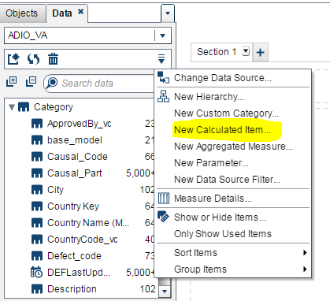
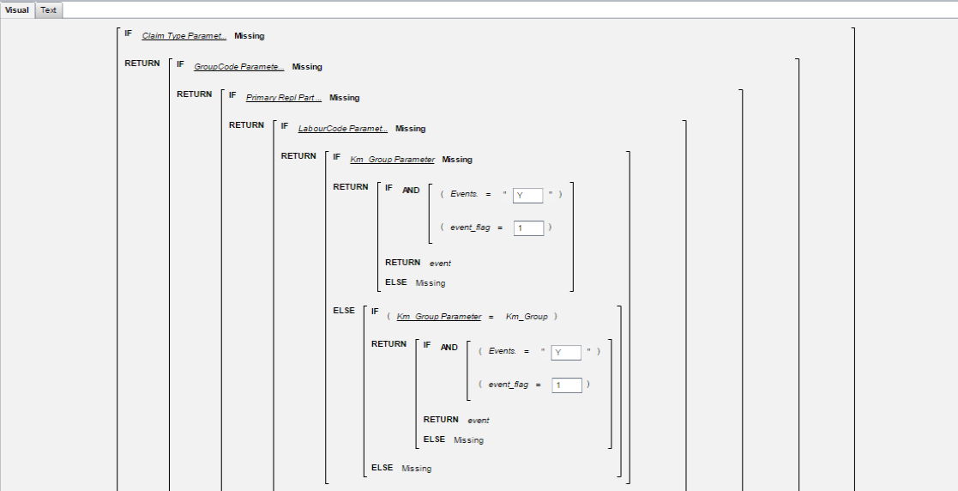
Step2: Create a new calculated item using Nested “IF_RETURN_ELSE” statement and use this calculated item as Event in the charts/graphs.
Notes:
This formula may seem too complicated. However, it is simpler to create the IF-RETURN-ELSE nests in the visual mode of calculations in SAS® Visual Analytics
Note: The attributes of Manufactured and Sold like Model Type, Variant etc. can be directly interacted with the charts/graphs as they will naturally filter both Events and MnS Nos.

Slide 27
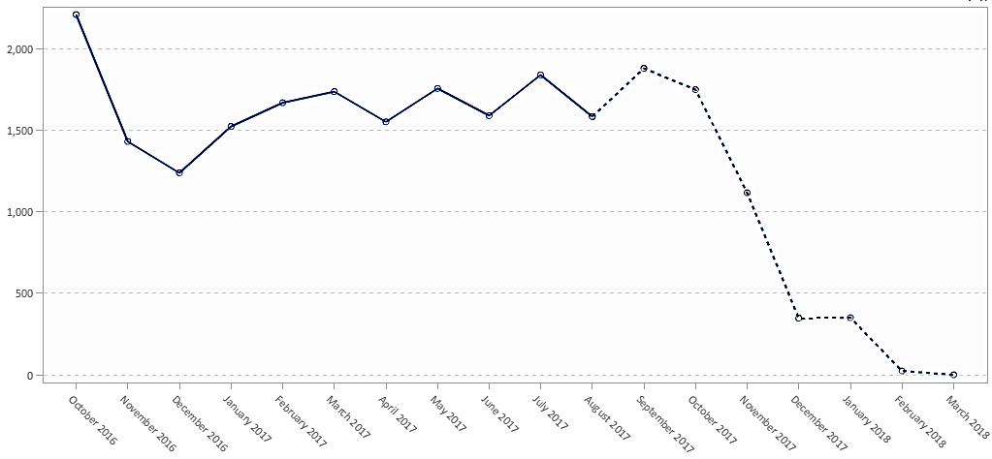
2. Dotted line to denote immature production batches
In Trend charts, the trend line for immature Prod. batches was required to be denoted through dotted lines
Business understanding for maturity: 95% of the vehicles are sold within 3 months from manufacturing
For a Prod. batch to be matured for 0 TIS it should be at least 3 months old.
E.g. The Batch of Feb-16 is said to be matured in Jun-16 (T+3Months + TIS = Feb + 3+ 0) for 0 TIS
Similarly, the same batch will mature in Sep-16(Feb+3 + 3) for 3 TIS.
Challenges
No display rule can be used for this purpose as:
Display Rules are not dynamic in nature. Every month a new batch matures and the trend line should become solid for that month.
Applying different display rules for different TISs is not possible.
Notes:
Maturity - meaning that we can assume that we will not receive any further events under 0 TIS from this batch
In other words, if we are checking the report in Sep 2016, all the prod. batches after Feb-16 should be showed as immature for 3 TIS (the trend line should be dotted) as we can assume that there will be more events coming in from these batches under 3 TIS.

Slide 28
Solution
Split the measure (Event) in to 2 parts – Event1 and Event2.
Create a custom Line chart with 2 measures (Event1 and Event2), a shared category (Prod. Month) and a shared group variable (TIS)
Calculated Event1 :
If Prod. Months are matured then
Event1 = . (missing)
Assign Event1 to the dotted line (so the trend-line only appears for the immature batches)
Calculated Event2 :
If Prod. Months are immature then
Event2 = . (missing)
Assign Event2 to the solid line (so the trend-line only appears for the mature batches).
Prod. months for which Event1 is “missing”, Event2will be “not missing” and Vice-Versa.

Slide 29
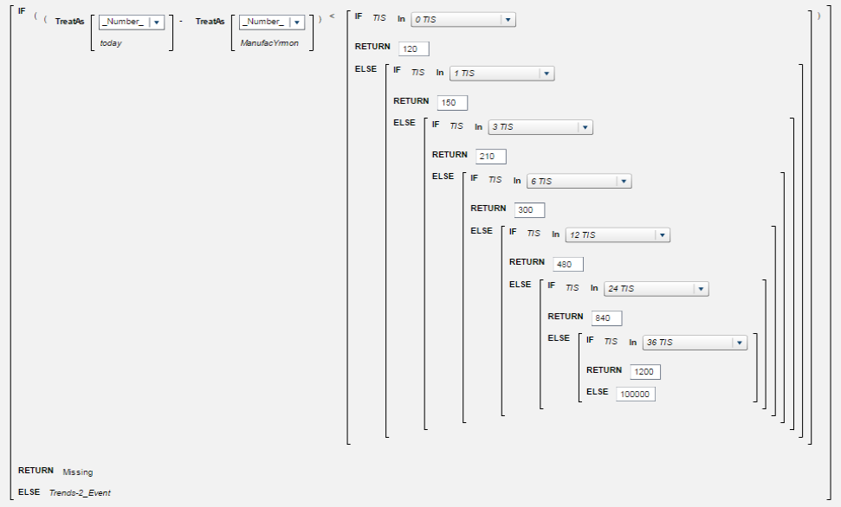
Event1:

Slide 30
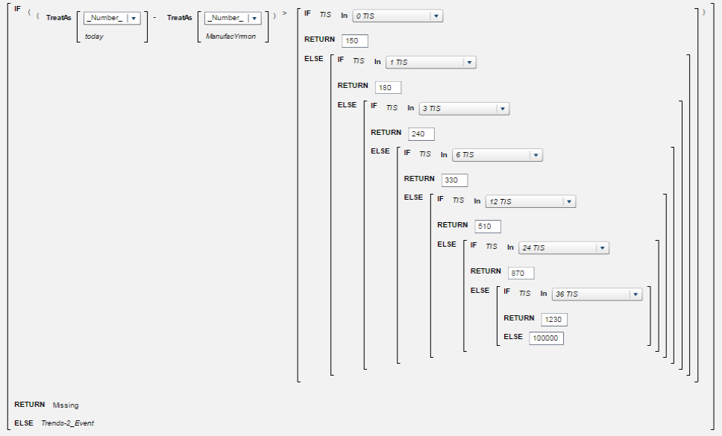
Event2:
Note: Event1 and Event2 are calculated according to the difference between today and the production Months.

Slide 31
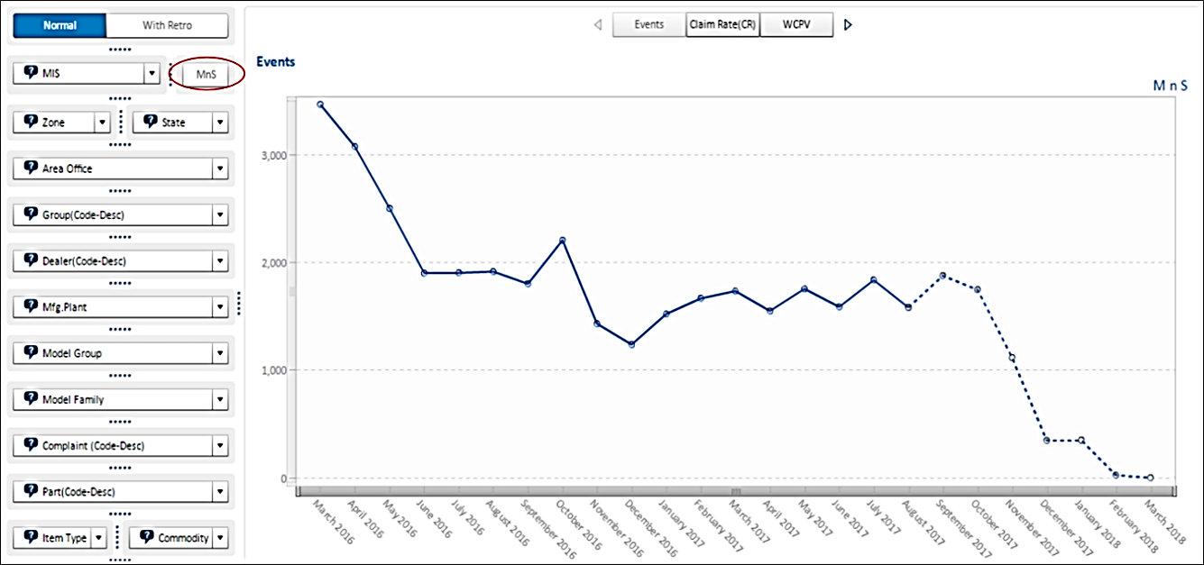
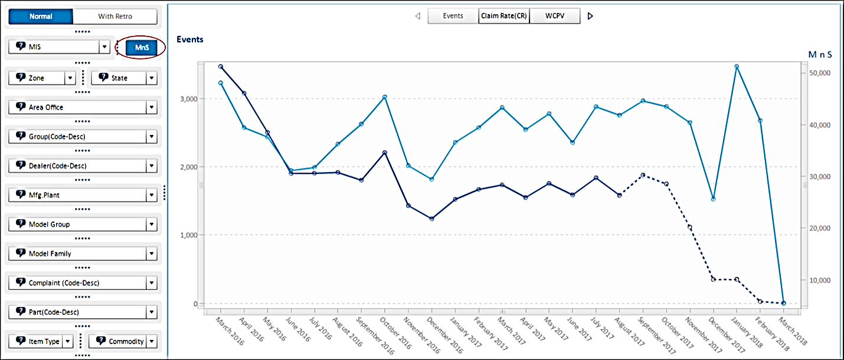
3. Dynamically Display/Remove Trend-line
Populate the MnS trend line on click of a button on the same graph on which events were plotted to compare the Events from a particular production month with the number of sold vehicles from that batch
Trend line for MnS nos. displayed on click of a button

Slide 32
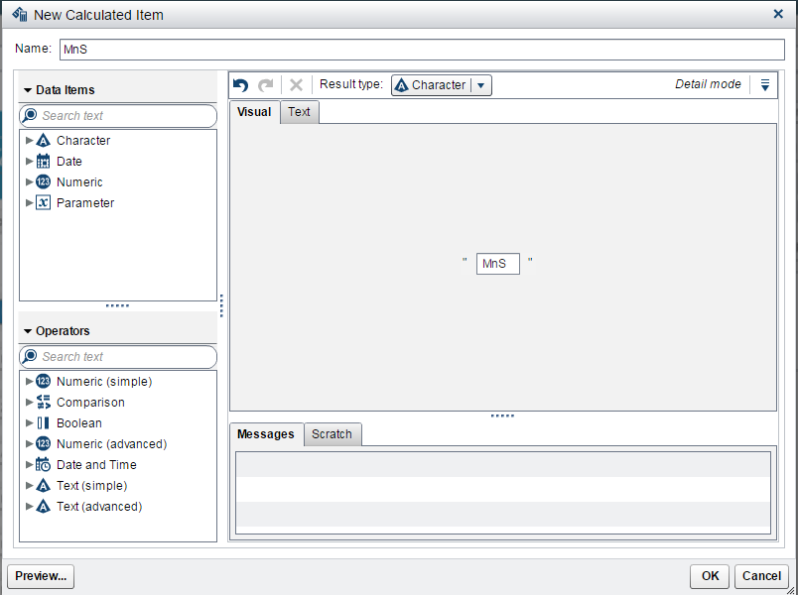
Solution
The solution lies in Parameters and Calculated Items:
Step1: Create a calculated item in the report (A character with value “MnS”)

Slide 33
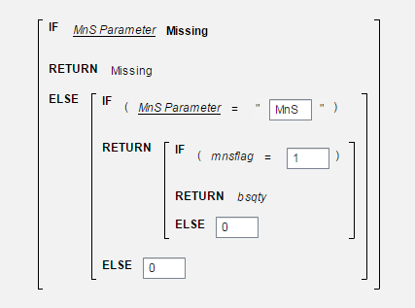

Step 2: Assign this item to a button Bar and create a Character Parameter on the Button
Step 3: Calculate the MnS nos. as:
If MnS parameter is missing,
then Sales = . (missing)
If MnS parameter = “MnS”,
then sales = ‘Sold Qty.’
Logic for Trend line show hide on click of MnS button.

Slide 34
Scope for Future Work
A ground to take-off Predictive Journey for Warranty Analytics
Going beyond Visual Analytics (Descriptive Analytics) – Using other SAS tools for Predictive and Prescriptive Analytics:
End-to-end solution for warranty analytics - SAS Field Quality Analytics
Early Warning Analysis for emerging issues identification
Reliability Analysis for warranty claim cost and frequency forecasting to initiate proactive maintenance
Efficient Text Mining on Technician and Customer Comment
On-demand solution to cater needs for Warranty Analytics:
Automated system for Real time Tracking and Sustenance of Concerns
Interactive platform for prediction of RPT/CPU for immature batches

Slide 35
Summary
Calculated items in combination with parameters enables to create a number of functionalities that aren’t directly available in SAS Visual Analytics 7.3 or earlier versions
These functionalities/techniques can be applied in analytics across industries for different purposes and requirements
SAS Visual Analytics is a strong analytical tool that can be used for ‘on-the-fly’ reporting and analysis of data where the value of a KPI depends upon the user’s selection

Slide 36
Your Feedback Counts!
Don't forget to complete the session survey in your conference mobile app.
Go to the Agenda icon in the conference app.
Find this session title and select it.
On the Sessions page, scroll down to Surveys and select the name of the survey.
Complete the survey and click Finish.

